Slide 1
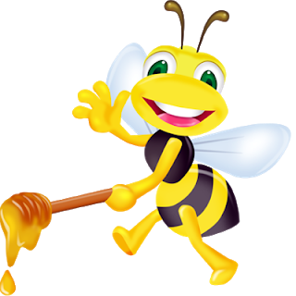
Catch the buzz
Beekeeping at school

Slide 2
Why keep bees?
The world needs bees
Bees are fun and educational
Beekeeping gets kids away from electronics and out into the real world
Bees teach us as much as we learn from them

Slide 3
A world without bees – would bee no world at all

Slide 4
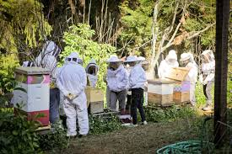
Bee hands on!

Slide 5
Start a beekeeping club at your school -
So what do I need?

Slide 6
Here’s what you need to start a bee club in your school
Bee keeping system – Equipment, training, support and educational materials
Bee suits to allow students to safely interact directly with the bees
Winterizing Kit –
Honey bees !
Mentor

Slide 7
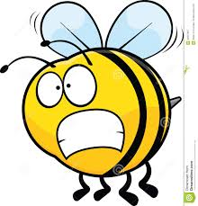
That’s a lot of Money!

Slide 8
Well yes – but there’s great news!
Grants are available for schools to start beekeeping projects!
Visit www.beepods.com/honey-beehive-grant-schools-usa/
Visit https://thebeecause.org/index.php/grant-program
Visit https://thehoneybeeconservancy.org/beekeeping-grants/
Visit https://www.wholekidsfoundaiton.org/schools/honey-bee-grant

Slide 9
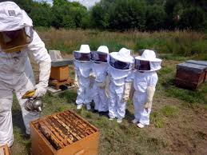
But I’m scared of bees!
Don’t bee! Adult supervision is always part of a beekeeping program and a good suit and good attitude will quickly show you bees are our friends!

Slide 10
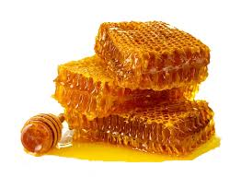
And Bees give back!!
Sweet, wonderful honey!

Slide 11
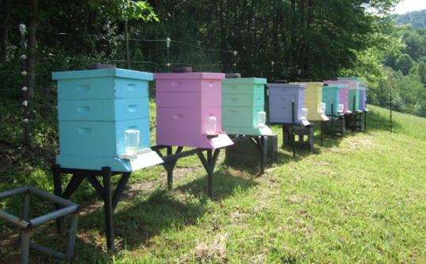
Bee part of saving the world and start keeping bees!

